Slide 1


SEICHE 2023 Intermediate Arduino Programming for IoT
Instructor: Paul Frommeyer
www.paulfrommeyer.com
Corporate Sponsor: DXC Technology

Slide 2
YOUR INSTRUCTOR
Career
Computer Infrastructure Engineer (30+ yrs)
Apple Computer – Sony – General Magic
Cisco Systems – HP/HPE/DXC [current]
Linux/Unix Sysadmin (20+ years)
C developer (professionally just entry level)
BS Computer Science, BS Philosophy
Personal
Ubergeek-at-large
Computers, electronics, woodworking - Electronics since 6th grade - Computers since 7th grade

Slide 3
Class Format and Goals “Understanding of Arduino programming using ESP8266 for IoT”
Goals
Understanding of C preprocessor operations
Understanding of variable internals and use of pointers
Basic understanding of FAT and related filesystems
Ability to use SPIFFS for file storage on ESP8266
Basic understanding of HTML language and HTTP protocol
Ability to create access points and web servers with ESP8266
Basic understanding of network messaging with Arduino
Basic usage of git and github for document version control
To Be Avoided
Detailed electronics knowledge and physical wiring of components
Processor internals and microcontroller internal architecture
Extensive math, computer science, or EE
Higher order web technologies like Java, JSON, and CSS

Slide 4
Lesson Plan Overview
Lesson 1 and 2: 7Feb23 – Review, Addressing, and Pointers
Overview of lesson plan
Class Exercise: Validation of sketch uploading
Class Exercise: Validation of binary create and upload
More on the Preprocessor
Memory Organization and Variables
Review of addressing and pointers
Using pointers to variables
Declaring pointers in function calls
Call-by-value Function Calls
Call-by-reference Function Calls
Lesson 3: 14Feb23 – More Gory Details
Class Exercise: Call-by-reference variables
Introduction to Complex Data Structures
Using complex data structures
Class Exercise: Declare and use complex data structures
Introduction to linked lists
Linked list usage example
Different storage types
Storage declarations and Arduino
Lesson 4: 21Feb23 – Fonts Redux
Bitmap font architecture review
MD_Parola library font usage review
The MD_Parola font format
Designing your own fonts
Declaring your own fonts
Using your own fonts with MD_Parola
Lesson 5: 28Feb23 – Intro to Visual Studio Code
Introduction to VSC
https://code.visualstudio.com/docs/introvideos/overview
Installation
Lesson 6: 7Mar23 – Filesystems
Introduction to mass storage filesystems
The SD FAT, FAT16, and FAT32 filesystems
The exFAT filesystem
Introduction to SPIFFS
Class Exercise: Using SPIFFS
Lesson 7: 14Mar23 – WiFi
Review of WiFi technology (but no gory details)
Class Exercise: Review of WiFi access with WiFi Manager
Creating access points with ESP8266
Class Exercise: Creating an access point
Lesson 8: 21Mar23 – Web Technology
Introduction to HTML
Web server and client architecture
Creating web servers with ESP8266
Class Exercise: A basic web server for time and temperature
Lesson 9: 28Mar23 – Arduino Web Services
Storing web pages using SPIFFS
HTML forms
Form processing with Arduino
Class Exercise: Displaying text entered on a web page
Obtaining weather information from the Internet
Class Exercise: Displaying weather information
Lesson 10: 4Apr23 – IoT Messaging and MQTT
Introduction to IoT network messaging and MQTT
Subscribing to an MQTT service
Publishing to an MQTT service
Class Exercise: Using MQTT and WiFi
Lesson 11:11Apr23 – Version control and Git
The need for document version control
The Git version control system
Installing Git
Using Git
Introduction to Github
Using Github
Class Exercise: Signing up for a Github account
Lesson 12:18Apr23 – Using VSC
VSC plugin review
Using VSC with Arduino
Using VSC with Git

Slide 5
USB Flash Drive Inventory
DOCUMENTATION – Arduino Reference
Programming with Arduino.pdf
Arduino Cookbook-2ndEdition.pdf
Arduino-For-Beginners-REV2.pdf
IntroArduinoBook-AlanSmith.pdf
IntroductionToArduino-Book-AlanGSmith.pdf
Make_Getting_Started_with_Arduino_3E.pdf
DOCUMENTATION – Electronics Reference
the-original-guide-to-boards-2021.pdf
Basic Electronics-Semiconductors.pdf
Grobs Basic Electronics 2010.pdf
Instructables-Basic-Electronics.pdf
Intro to Electronics-Noisemantra.pdf
Make Electronics 2nd Edition by Charles Platt.pdf
SPIE-TT107-PracticalElectronicsforOpticalDesignandEngineering-Chapter1.pdf
DOCUMENTATION – Internet of Things (IoT)
Internet of Things With Arduino
Building Arduino Projects For The Internet Of Things
DOCUMENTATION – ESP8266
ESP8266 pinout diagram
DOCUMENTATION – Boards Guides
Original Boards Guides from 2019-2022
DOCUMENTATION – Class Information
SEICHE-BasicArduinoProgramming-Lesson1-V1.pdf
SOFTWARE – Visual Studio Code
Windows x64
“User” non-elevated installer
“Normal” elevated installer
Kubuntu x64
.deb package for use with Aptitude (apt-install)
Critical Documents
Internet of Things With Arduino – Use this for reference and class excercises
Building Arduino Projects For The Internet Of Things – Use this for advanced self-study
RETURN FLASH DRIVES AT END OF EACH LESSON
I’ll load new content each week, at least that week’s lesson but also sketches when needed

Slide 6
Lesson 1 – Review, Addressing and Pointers
Part A
Overview of lesson plan
Inventory of USB Drives – New files
Review of ESP8266 connection and software upload (Class Exercise)
Part B
More About the Preprocessor
Memory organization and variables
Addresses and pointers
Using pointers to variables
Pointers and Arrays
Dereferencing
Call-by-value and Call-by-reference in function calls

Slide 7
Preparing a Sketch
Launch the Arduino IDE by double clicking on the sketch SKETCH1A which has been copied to your hard drive (do not use the sketch on your USB drive!)
Click on the “VALIDATE” check mark icon
DO NOT click on the “right arrow” (UPLOAD) icon at this time
This will compile the sketch and check for errors prior to upload
This is normally an optional step, since selecting upload will always compile the code first.
Whenever using a new board (or library) for the first time, it’s a good idea to validate just to assure the software is happy before attempting and upload
We are (re)validating that all your libraries, and particularly your board definitions, are still in place and working.
X
This check mark icon is for VALIDATE

Slide 8
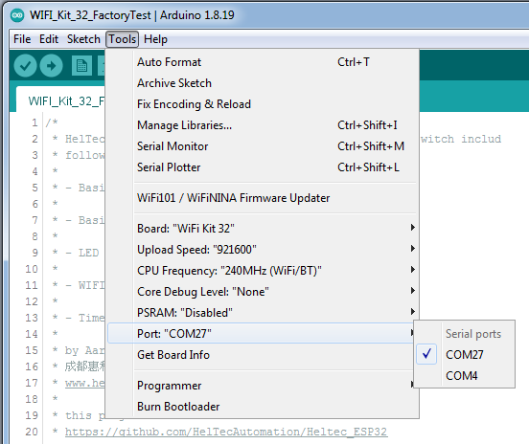
Finding and Setting the USB Port
WINDOWS
Use Device Manager to identify the USB port
The port will change with each connect/disconnect of the board
KUBUNTU
Port should always be /dev/ttyUSB0
The port will not change with connect/disconnect
You can use Konsole to verify the port presence ls /dev/tty*

Slide 9
Adjusting Port Speed
Always start by using 921600, this works with nearly all USB chipsets (there are exceptions for the ESP32, which uses the Sil2102 driver– but that’s not us!)
If you get an upload failure
Recheck port setting
Retry the upload with the next lowest speed
Lather, rinse, repeat until success
Suggested initial try order: 921600, 512000, 115200

Slide 10
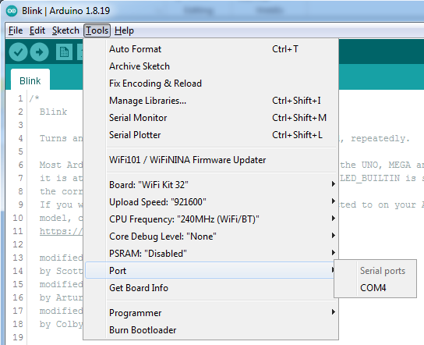
Uploading a Sketch
Ensure you have selected the correct port for your currently plugged in board
NOW click on the “UPLOAD” arrow icon
Once upload is finished, the sketch will immediately run
You should a message scroll on your displays
As before, feel free to change the text message if you want

Slide 11
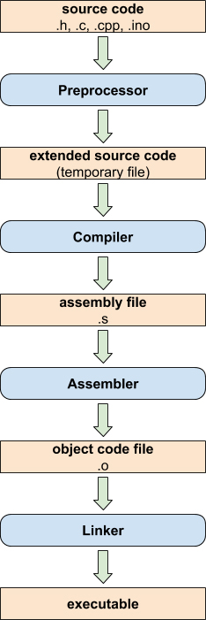
Arduino IDE Compile Sequence
Before your sketch can be uploaded, it must be compiled into a machine language file which the microcontroller can understand and execute. There are several steps involved in the compilation process; these can vary by langauge and/or IDE, but at left is the compiler flow for the Arduino IDE

Slide 12
More About The Preprocessor
Before the C/C++ code of a sketch is compiled into machine code, a preprocessor is run over the code. The preprocessor reads certain directives which are used to transform the sketch code.
/* and */ – Any text between these comment delimeters is removed along with the delimeters
// – Any text following this comment delimeter before another preprocessor directive or code statement is removed
#include – specifies a file with additional code that should be directly included/incorporated into the sketch at the location where the #include occurs
#define – Specifies a keyword variable which will be substituted for it’s defined text wherever it occurs throughout the code
#ifdef – Executes conditional code if the specified keyword variable has been defined
#ifndef – Executes conditional code if the specified keyboard variable has not been defined

Slide 13
The #include directive
#include is used to incorporate code from files “external” to the sketch it is used in
#include “somefile.ino” Path specifier usage - includes a file from the same directory, or absolute directory path, as the sketch containing the directive
#include <foo.h> Library usage – checks standard library locations for the file to be included. Most often used for header files to invoke a library to be used with the containing sketch. Some versions of C/C++ treat the .h suffix as optional when <> library specifier is used

Slide 14
The #define directive
#define is used to declare “substitute” text which will be globally replaced when used
#define FOO SEICHE2023 Will replace all occurences of “FOO” in the sketch with the text “SEICHE2023” wherever it occurs
#define TRUE 1 Will cause all usages of “TRUE” to be replaced with the numeral 1. This is actually a system default definition already made by the IDE
#define NULL 0 Will cause all usages of “NULL” to be replaced with the numeral 0. Here again, this is actually a system default definition already made by the IDE – it’s already been defined for you.
Note: redefining a preprocessor variable will throw a warning message in the IDE, however the variable WILL be redefined.

Slide 15
The #ifdef and #ifndef directives
#ifdef is #ifndef are used to execute conditional code if a preprocessor variable has or has not been defined, respectively
#ifdef LASTYEAR char message[] = “SEICHE2022” #endif Will declare the string “message” with ASCII text “SEICHE2022” if preprocessor variable FOO has been defined. It does not matter what FOO has been defined as.
#ifndef LASTYEAR char message[] = “SEICHE2023” #endif If LASTYEAR has not been defined, then declare “message” with “SEICHE2023”

Slide 16
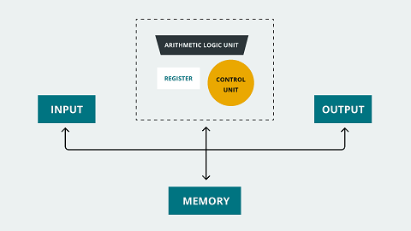
Memory Organization and Variables Memory Architectures
Von Neumann – A single monolithic memory (one big pool) is used for everything– program storage, predeclared variable storage, dynamic variable storage, input, output, the works.
Harvard– Discrete pieces of memory– usually physically separate chips– are used for the different operations of the computer. This architecture is preferred in microcontrollers, particularly those used by Arduino

Slide 17
Memory Types
Flash – This is where firmware is stored to be executed; this is where the compiled binary files from the IDE are stored.
RAM – This is where temporary, or “run-time”, data is stored. RAM in microcontrollers is usually SRAM.
SRAM - “static RAM”, which means contents persist even if power is removed for a relatively short time. SRAM is usually slower than DRAM.
DRAM – “dynamic RAM”, requires constant refreshing by circuitry or data is lost. Even a 1 nanosecond signal fluctuation can corrupt DRAM. DRAM is usually faster than SRAM, which is why DRAM is the hardware of choice for laptops and servers.
EEPROM - In microcontroller-based systems, Erasable Programmable Read-Only Memory, or EEPROM, is also part of its ROM; actually, Flash memory is a type of EEPROM. The main difference between Flash memory and EEPROM is how they are managed; EEPROM can be managed at the byte level (write or erased) while Flash can be managed at the block level.

Slide 18
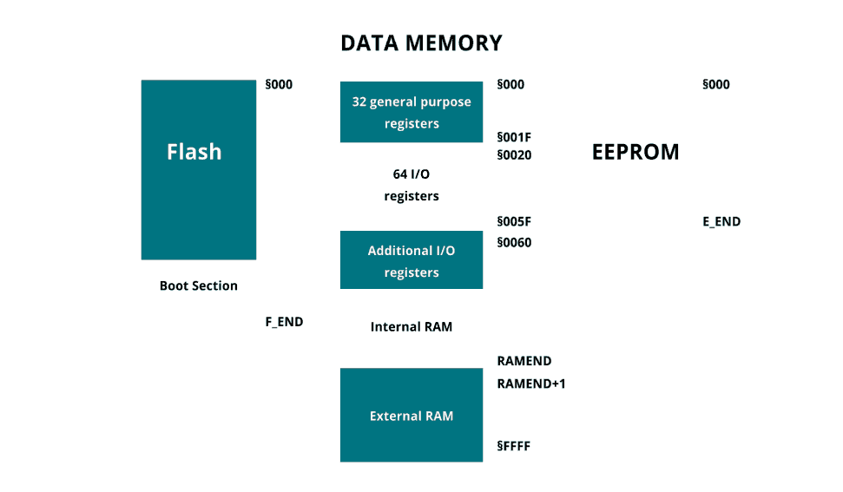
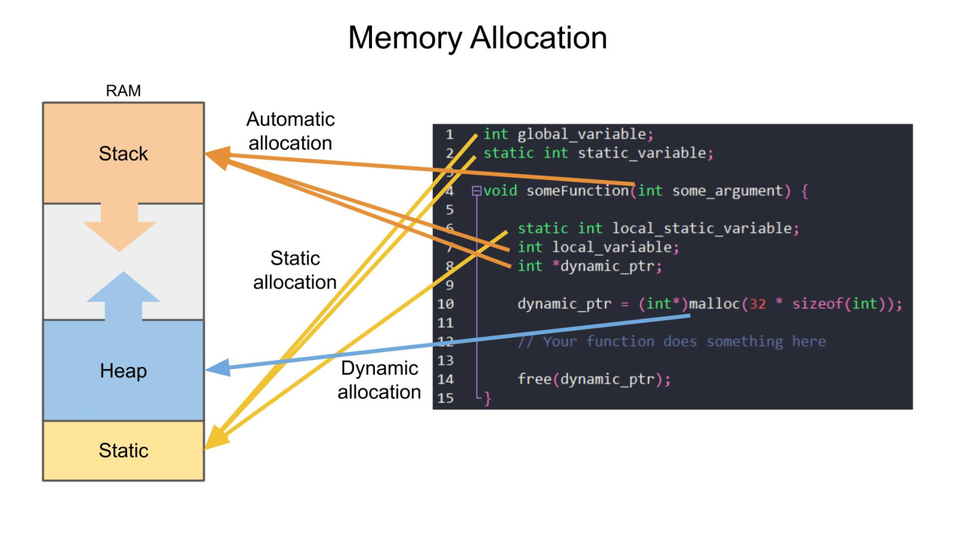
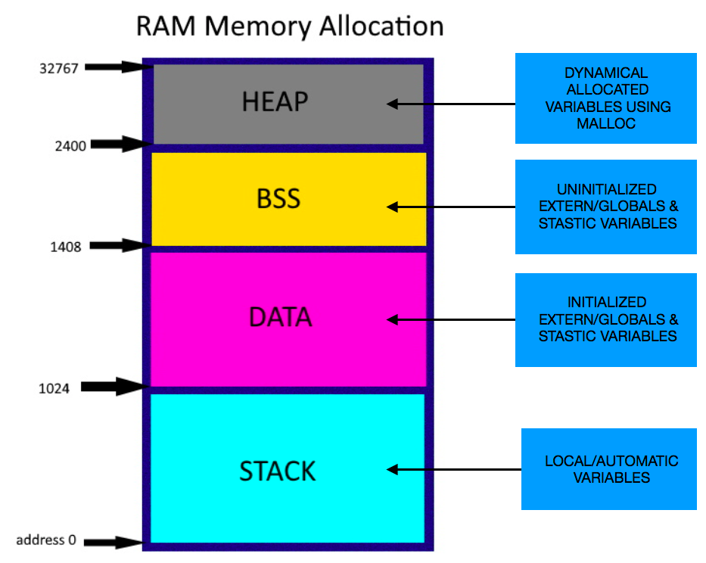
Memory Organization and Variables Arduino AVR Memory Model
How memory is organized in a computer is called a memory map. The memory map determines where program code and predeclared and dynamic variable data are stored in the computer’s memory. Different types of memory can be used for the different types of data; this is especially true for microcontrollers.

Slide 19
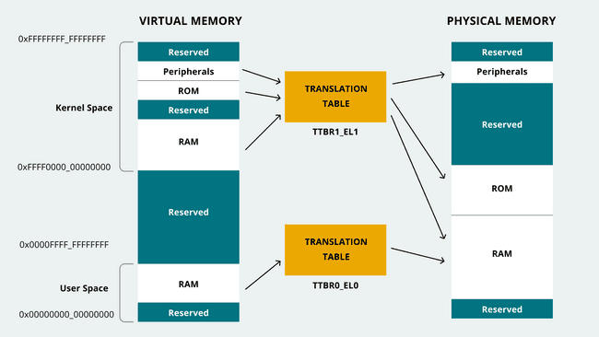
Memory Organization and Variables Arduino ARM Memory Model
ARM and related microcontrollers utilize a scheme called virtual memory, where a small amount of physical memory is mapped (“translated”) into a vastly larger virtual memory space. Infrequently used virtual memory storage is “paged out” to slower storage media, such as flash, while unused virtual memory addresses are simply ignored.
While the original microcomputers of the 1970’s and early 1980’s all used physical memory, all modern laptop and server operating systems use virtual memory.
https://docs.arduino.cc/learn/programming/memory-guide

Slide 20
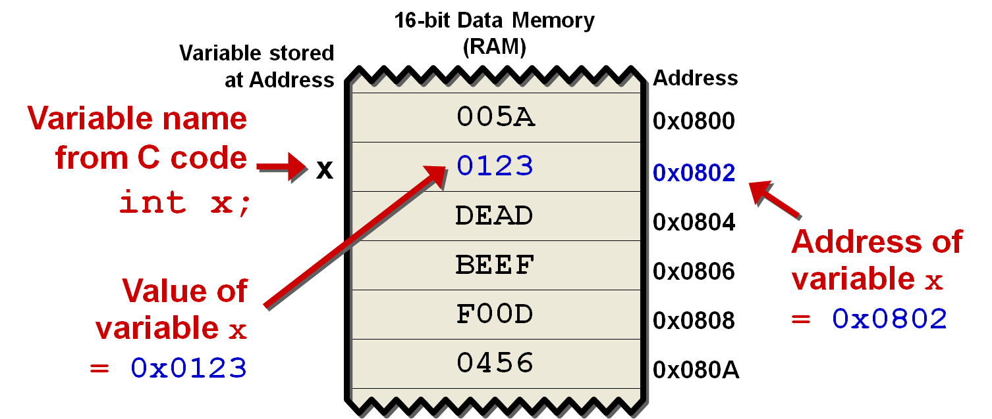
Memory Organization and Variables Variable Data Storage
Variable data is stored at specific locations in memory; we touched on this last semester. Each variable has a “starting location” which is a specific address in memory. How many bytes are consumed at that location by the variable depends on its type, or in the case of strings, contents.

Slide 21
Addresses and Pointers
We’ve learned that a variable is data stored in memory, and that the contents of most variables can be modified (hence the name ☺)
The “contents” of a variable are the data stored at the first memory address for all the bytes comprising a given variable.
As a shorthand, the phrase “address of a variable” refers to that first byte of the variable’s data structure
The address of a variable is itself data. Depending on the architecture, the address may be 8, 16, 32, or even 64 bits in size
It logically follows, then, that the address of a particular variable can itself be stored in another, different variable.
A variable which is used to store the address of another variable is called a pointer.

Slide 22
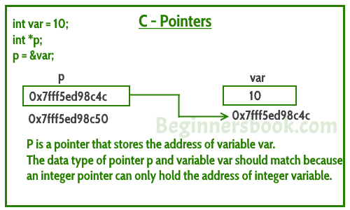
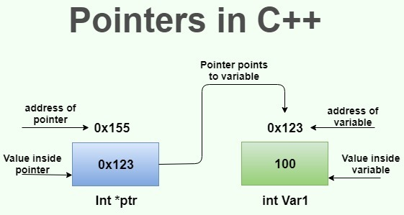
Addresses and Pointers (cont.)
int foo = 10;
The syntax for declaring a pointer is int *p; // or uint64_t *p;
And the syntax for accessing and assigning the address of a variable to a pointer is p = &foo;
Do not confuse prefix use of the asterisk (*) for a pointer with infix use as an arithmetic operator!

Slide 23
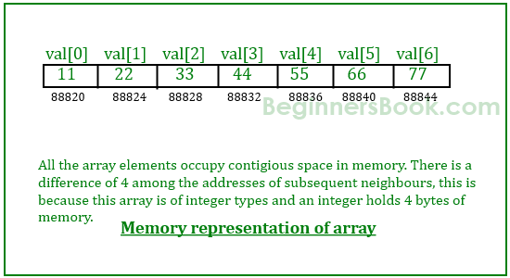
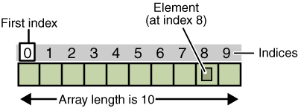
Using Pointers With Arrays
Recall that arrays are sequential data structures with variables of a given type accessed by index char bar[4] = “foo”;
Each byte of the character array bar resides at a subsequent address in memory
As you may recall, the individual array members are “found” by the computer simply by adding the size of the array type to the base index of the array, which is zero.
This process happens “behind” the scenes, but the way it is done is that the base “index” of zero is actually the address of the first member of the array.
Then, to reach subsequent members, the address is incremented by the size of the array data type

Slide 24
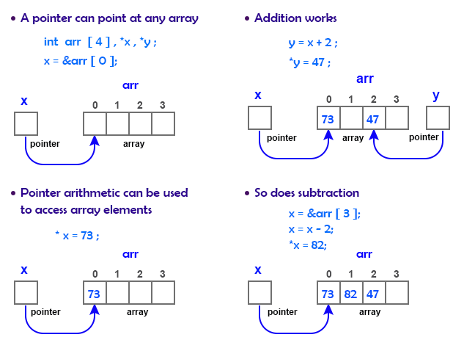
Using Pointers With Arrays
Since pointers are variables, they can be manipulated with arithmetic operators
In particular, addition and subtraction will cause a pointer to reference a different address in memory
And this is how the computer does it for accessing the individual elements of an array
It is possible to perform these operations “manually” using the address operator & and the pointer operator *.

Slide 25
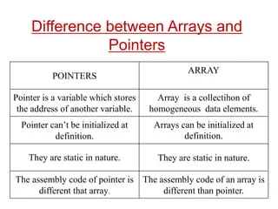
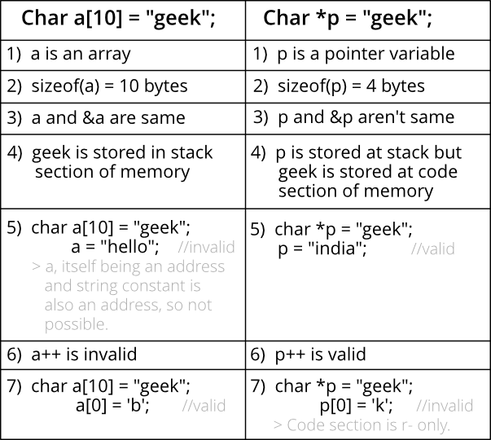
Differences Between Arrays and Pointers
More detailed exposition of this content
https://www.youtube.com/watch?v=ToPkRyNOBZ8

Slide 26
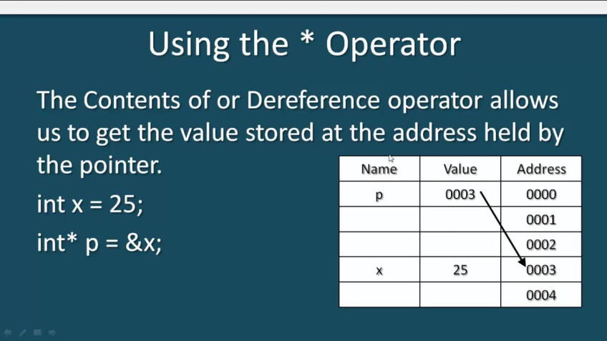
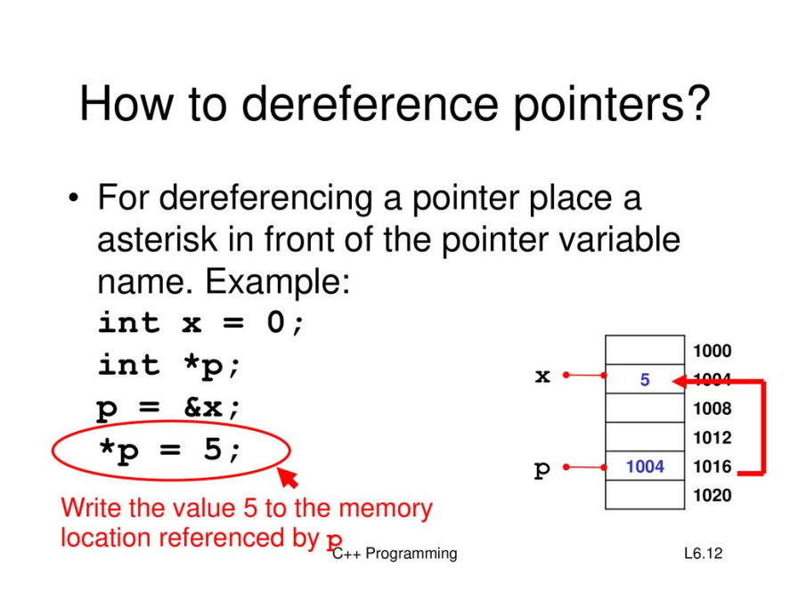
Dereferencing
So if we have a pointer, how do we use that pointer to access the contents of memory at that location?
The process of accessing memory contents from a pointer is called dereferencing
Dereferencing also uses the asterisk *
How an asterisk is processed depends on where in a C statement it is used. Just be careful not to confuse pointer operations with arithmetic operations.
A variable is dereferenced thusly: foo = *bar;

Slide 27
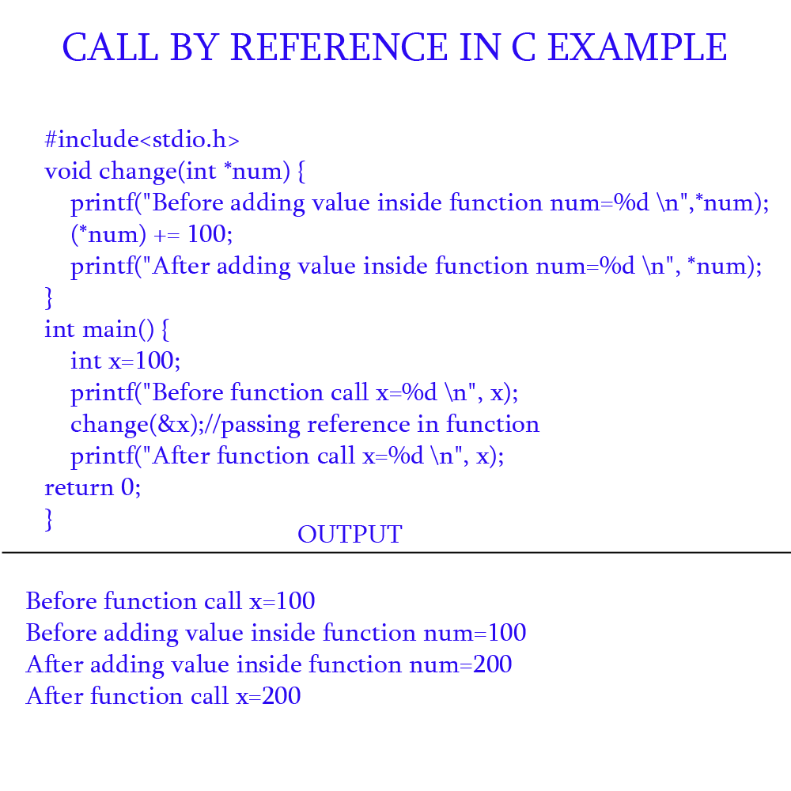
Pointers, Functions, and Call By Reference
So far, when you passed a variable to a function, only the value of that variable was passed to the function. Modification of the passed value within the function would not affect the original variable.
Passing the value of a variable in a function is referred to as call by value.
However, it is possible to pass the address of a variable, rather than it’s value. This allows the contents of the original variable to be modified.
This is referred to as call by reference.

Slide 28
Formal End of Lesson 1
HOMEWORK!
No explicit homework
Have a look at the new IoT books added to your flash drives
In next week’s exciting episode
Introduction to complex data structures
Using complex data structures
Class Exercise: Declare and use complex data structures
Introduction to linked lists
Linked list usage example
Different storage types
Storage declarations and Arduino

Slide 29
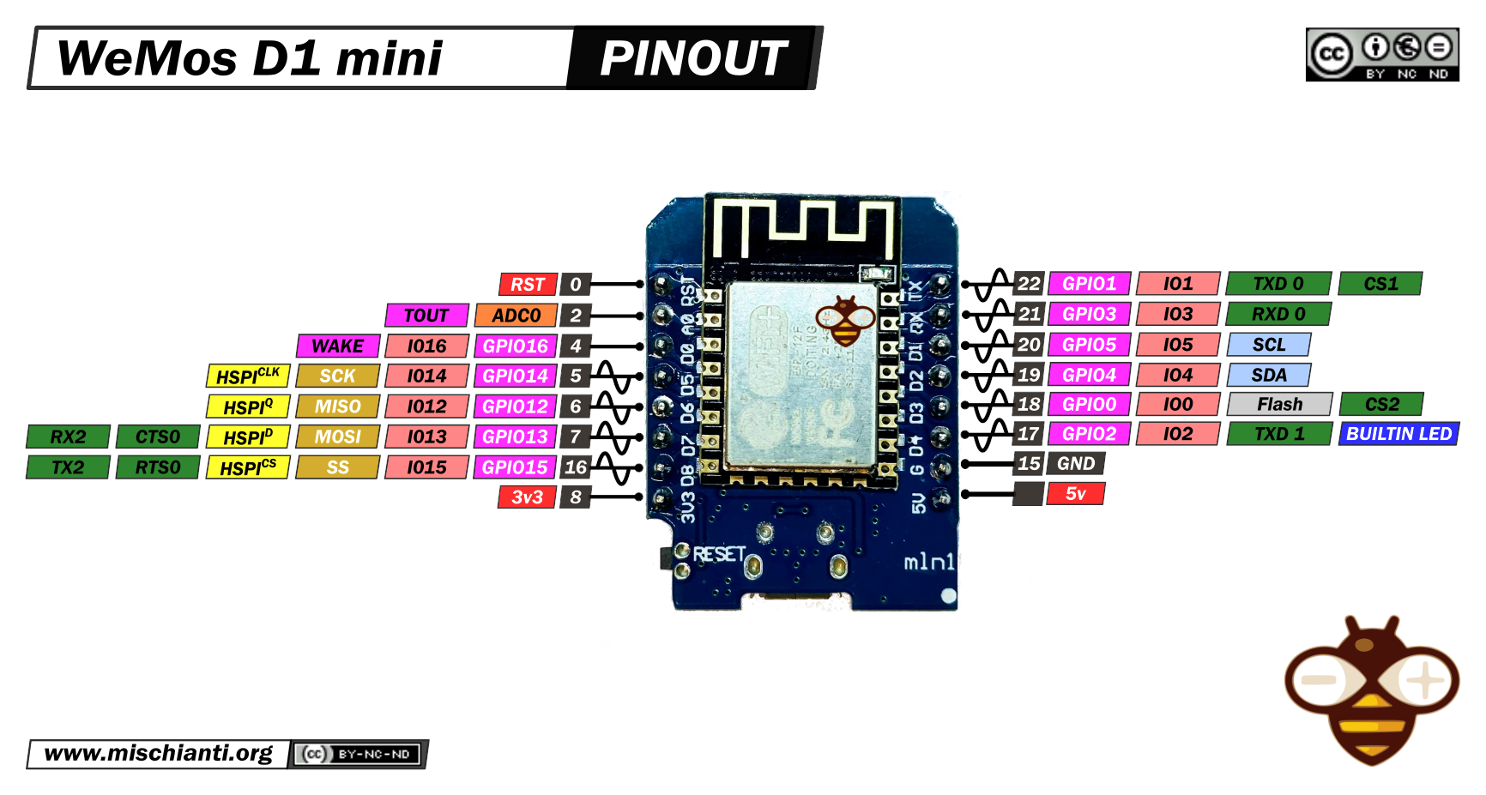
Our Microcontroller: The WeMos D1 Mini
Hilights
11 digital IO: all are interrupt and pwm capable (except D0/GPIO16)
1 analog input (3.2V max input): A0/ADC0
Micro USB or Type-C USB Port (clones usually have micro USB)
Two SPI interfaces (one is used for on-board flash memory), one I2C interface, two serial ports
Built-in WiFi (client or standalone access point modes) and Bluetooth
Compatible with MicroPython, Arduino, NodeMCU
Uses the CH340 USB-to-serial driver (installation usually needed on Windows)
Extremely low cost (approx $3.00 US on Amazon; one of the two least expensive components in your kits)

Slide 30
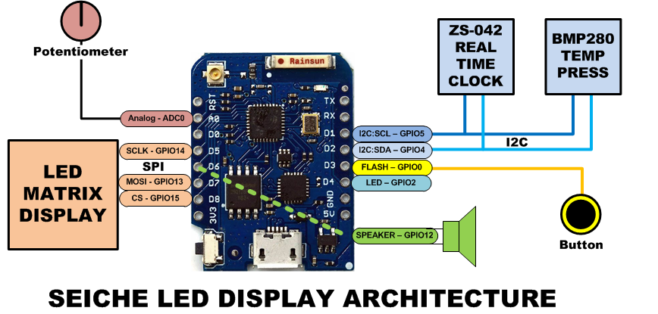
SEICHE LED Display Architecture
Red MAX7219 8x32 LED matrix display (SPI)
ZS-042 real-time clock module (I2C)
BMP280 Temperature and Pressure Sensor (I2C)
Piezoelectric speaker (PWM)
10KΩ Potentiometer (Analog-to-Digital Converter)
Button (Pullup and interrupt)

Slide 31
sprintf() Function Syntax
sprintf()’s formal syntax is: sprintf(char *buffer, const char *format, variable list)
buffer is an array of type char (the parameter when passed can also be a pointer [address] for such an array) which will contain the formatted output of the function
format is an unmodifiable (constant) array of char containing the format descriptors for all variables subsequently passed to the function, which is to say, it’s the format string.
The variable list are just the comma separated variables that are to be formatted
All variables passed in a single call to sprintf() are combined into a single output string
sprintf() automagically puts a terminating NULL (\0) at the end of the ASCII output

Slide 32
sprintf() Format Strings
sprintf() format strings contain conversion specifiers that specify how each individual variable is to be converted
sprintf() conversion specifiers have the following general syntax (all begin with a percent-sign):
%[flags][minimum field width][.][precision][length][conversion character]
% - special token that indicates the start of a conversion specifier
Flags – these modify the behavior of the specification
Minumum field width – as it says on the tin; this the minimum number of characters to be converted
. – The period is a separator between field width and precision
Precision – means one of the following depending on the variable type and conversion specifier
The maximum number of characters to be generated from a string
The number of digits after the decimal point for type float conversions (e, E, or f)
The zero-filled minimum number of digits for an integer
Conversion character – A single character which determines the output type of the conversion specifier; a single character that specifies the type of output format for the corresponding data or variable

Slide 33
sprintf() Conversion Specifiers
Below are the general conversion specifiers and what they do.
Specifier | What it does
d, i | int - integer; signed decimal notation
o | int – unsigned octal (no leading zero)
x, X | int – unsigned hexadecimal, no leading 0x
u | int – unsigned decimal
c | int – single character, after conversion to unsigned char
s | char * - characters from string are printed until \0 (NULL) or precision is reached
f | double – decimal notation of form [-]mmm.ddd where number of decimals is specified by precision; precision of zero (0) suppresses the decimals altogether
e, E | double - exp notation; default precision of 6, 0 suppresses
g, G | double – Use %f for <10^4 or %e for >10^4
p | void * - print output as a pointer, platform dependent
n | Number of characters generated so far; goes into output
% | No conversion, put a % percent sign in the output

Slide 34
sprintf() Conversion Specifiers
Below are the flags and what they do.
Flag | What it does
- | Left justification
+ | Always print number with a sign
spc (space) | Prefix a space if first character is not a sign
0 (zero) | Zero fill left for numeric conversions
# | Alternate output form depending on conversion character o – first digit will be zero x or X – 0x or 0X (respectively) prefixed to non-zero results e, E, f, g and G – Output will always have a decimal point g and G – trailing zeroes will never be removed

